Slide 1
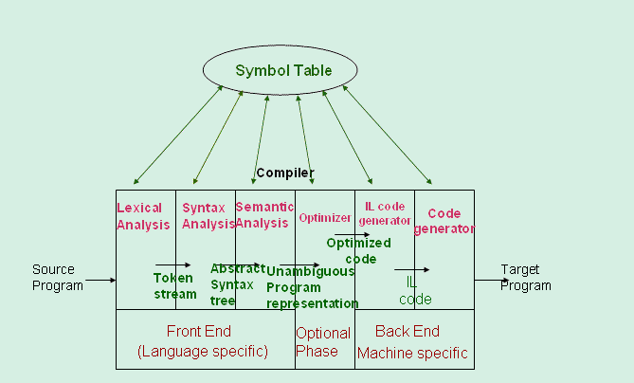

Slide 2
Advantages of the model
Also known as Analysis-Synthesis model of compilation
- Front end phases are known as analysis phases
Back end phases are known as synthesis phases
Each phase has a well defined work
Each phase handles a logical activity in the process of compilation
The Analysis-Synthesis model:
The front end phases are Lexical, Syntax and Semantic analyses. These form the "analysis phase" as you can well see these all do some kind of analysis. The Back End phases are called the "synthesis phase" as they synthesize the intermediate and the target language and hence the program from the representation created by the Front End phases. The advantages are that not only can lots of code be reused, but also since the compiler is well structured - it is easy to maintain & debug.

Slide 3
How does LEX work?
Regular expressions describe the languages that can be recognized by finite automata.
Translate each token regular expression into a non deterministic finite automaton(NFA)
Convert the NFA into an equivalent DFA
Minimize the DFA to reduce the number of states
Emit code driven by the DFA tables.

Slide 4
Lexical Analysis

Slide 5
Difficulties in the Implementation of Lexical analysers
Lexemes in a fixed position. Fix format vs. free format languages
Handling of blanks
in Pascal, blanks separate identifiers
in Fortran, blanks are important only in literal strings for example variable counter is same as count er
Another example
DO 10 I = 1.25 DO10I=1.25
DO 10 I = 1,25 DO10I=1,25

Slide 6
Recognition of reserved keywords and identifiers
To reduce the number of states, enter keywords into the symbol table as if they were identifiers.
When the LA consults the symbol table to find the correct lexical value to return, it discovers that this identifier is really a keyword, and the symbol table entry has the proper token code to return.

Slide 7
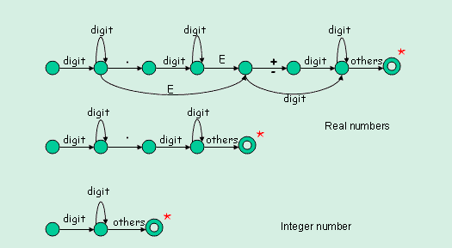
Transition diagram for unsigned numbers

Slide 8
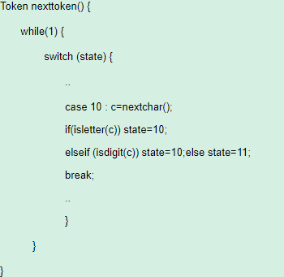
Implementation of Transition Diagram

Slide 9
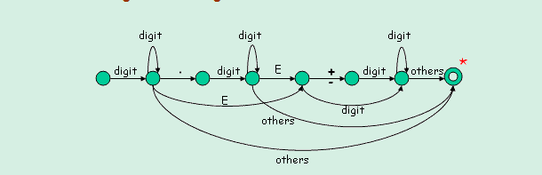
Another transition diagram for Unsigned Numbers
A more complex transition diagram is difficult to implement and may give rise to errors during coding, however, there are ways to better implementation.
Notes:
It is not advisable to reduce the number of transition diagrams at the cost of making them too complex to understand. However, if we use multiple transition diagrams, then the tradeoff is that we may have to unget() a large number of characters as we need to recheck the entire input in some other transition diagram.

Slide 10
Lexical Analyzer Generators
The process of constructing a lexical analyzer can be automated.
Input to the generator:
List of regular expressions in priority order
Associated actions for each of regular expression
Output of the generator:
Program that reads input character stream and breaks that into tokens
Reports lexical errors(unexpected characters), if any

Slide 11
Two popular lexical analyzer generators are
Flex : generates lexical analyzer in C or C++. It is more modern version of the original Lex tool that was part of the AT&T Bell Labs version of Unix.
An open source implementation of the original UNIX lex utility
Jlex: written in Java. Generates lexical analyzer in Java

Slide 12
Lex:
It is a lexical analyzer generator.
The input notation for the Lex tool is referred to as the Lex language.
The tool itself is the Lex compiler.
Behind the scenes, the Lex compiler transforms the input patterns into a transition diagram and generates code, in a file called lex.yy.c, that simulates this transition diagram.

Slide 13
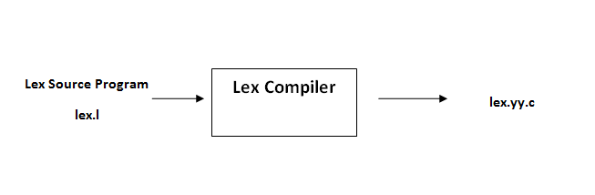
An input file which we call lex.l is written in the Lex language and describes the lexical analyzer to be generated.
The lex compiler transforms lex.l to a C program, in a file that is always named lex.yy.c

Slide 14
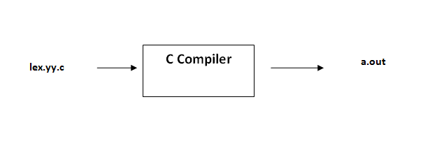
The latter file is compiled by the C compiler into a file called a.out, as always.
The C-compiler output is a working lexical analyzer that can take a stream of input characters and produce a stream of tokens.
The normal use of the C compiled output, referred to as a.out is a subroutine of the parser.

Slide 15
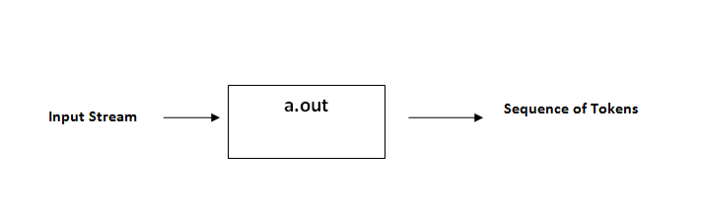
Fig: Creating a lexical analyzer with Lex

Slide 16
Structure of Lex programs:
A lex program has the following form:
declarations
%%
Translation rules
%%
Auxiliary functions (optional)

Slide 17
The declaration section includes declarations of
variables, manifest constants ( identifiers declared to stand for a constant), and
regular definitions.
The translation rules each have the form
Pattern {Action}
- Actions will contain the C code . A single statement or a code block.
Notes:
Each pattern is a regular expression which may use the regular definitions of the declaration section.
The actions are fragments of code, typically written in C, although many other variants of Lex using other languages have been created.
The third section holds whatever additional functions are used in the actions.

Slide 18
Lex Pattern Examples
abc | Match the string “abc”
[a-z A-Z] | Match any lower or uppercase letter
Dog.*cat | Match any string starting with dog, and ending with cat
(ab)+ | Match one or more occurrences of “ab” concatenated
[^a-z]⁺ | Matches any string of one or more characters that do not include lowercase a-z
[ + -]? [0-9]+ | Match any string of one or more digits with an optional prefix of + or -

Slide 19
Lex input example
Filename: example1.l
%%
“HI” printf(“Hello World”);
. ; //Empty C statement. Does nothing for any other character encountered in the input
%%

Slide 20
Executing the Lex File
lex example1.l
(Processes the lex file to generate a scanner which gets saved as lex.yy.c)
cc lex.yy.c –ll
compile the scanner and grab main() from the lex library(-ll)
./a.out
Run the scanner taking input from standard input

Slide 21
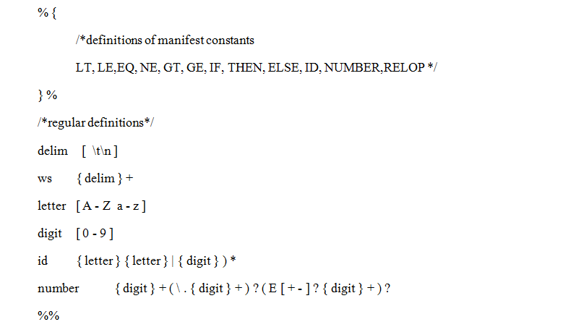

Slide 22
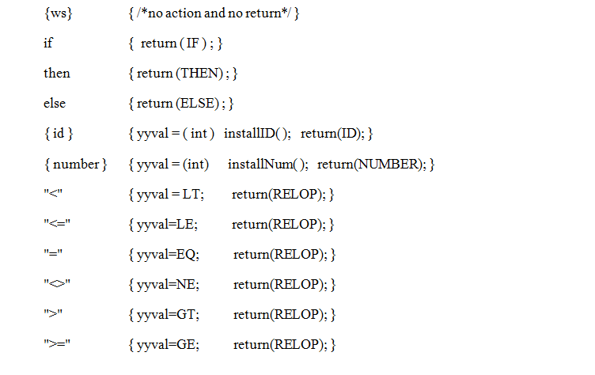

Slide 23
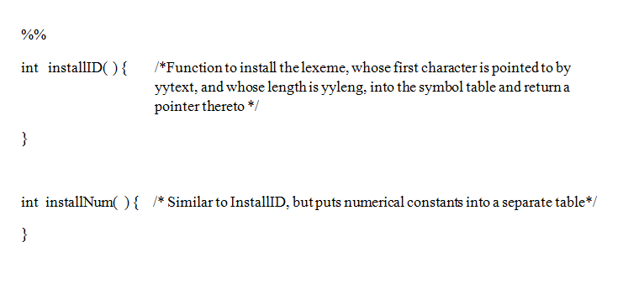
Fig: Lex program for the relational operators as tokens

Slide 24
For a trivial example, consider a program to delete from the input all blanks or tabs at the ends of lines.
%%
[ \t]+$ ;
is all that is required.
The program contains a %% delimiter to mark the beginning of the rules, and one rule.
This rule contains a regular expression which matches one or more instances of the characters blank or tab (written \t for visibility, in accordance with the C language convention) just prior to the end of a line.

Slide 25
To change any remaining string of blanks or tabs to a single blank, add another rule:
%%
[ \t]+$ ;
[ \t]+ printf(" ");
The first rule matches all strings of blanks or tabs at the end of lines, and
the second rule all remaining strings of blanks or tabs.
Notes:
The finite automaton generated for this source will scan for both rules at once, observing at the termination of the string of blanks or tabs whether or not there is a newline character, and executing the desired rule action.

Slide 26
Lex can be used alone for simple transformations, or for analysis and statistics gathering on a lexical level.
It is particularly easy to interface Lex and Yacc .
Lex programs recognize only regular expressions;
Yacc writes parsers that accept a large class of context free grammars, but require a lower level analyzer to recognize input tokens.
Thus, a combination of Lex and Yacc is often appropriate.
When used as a preprocessor for a later parser generator, Lex is used to partition the input stream, and the parser generator assigns structure to the resulting pieces.
Notes:
it is particularly easy to interface Lex and Yacc [3].

Slide 27
The general format of Lex source is:
{definitions}
%%
{rules}
%%
{user subroutines}
where the definitions and the user subroutines are often omitted. The second %% is optional, but the first is required to mark the beginning of the rules. The absolute minimum Lex program is thus
%%
(no definitions, no rules) which translates into a program which copies the input to the output unchanged.

Slide 28
If the action is merely a single C expression, it can just be given on the right side of the line; if it is compound, or takes more than a line, it should be enclosed in braces.
The operator characters are
" \ [ ] ^ - ? . * + | ( ) $ / { } % < >
and if they are to be used as text characters, an escape should be used.
Notes:
These rules are not quite enough, since the word petroleum would become gaseum; a way of dealing with this will be described later.

Slide 29
The quotation mark operator (") indicates that whatever is contained between a pair of quotes is to be taken as text characters. Thus
xyz"++"
matches the string xyz++ when it appears.
Note that a part of a string may be quoted. It is harmless but unnecessary to quote an ordinary text character; the expression
"xyz++"
is the same as the one above.

Slide 30
An operator character may also be turned into a text character by preceding it with \ as in
xyz\+\+
which is another, less readable, equivalent of the given expressions.

Slide 31
In character classes, the ^ operator must appear as the first character after the left bracket; it indicates that the resulting string is to be complemented with respect to the computer character set. Thus
[^abc]
matches all characters except a, b, or c, including all special or control characters; or [^a-zA-Z]
is any character which is not a letter.

Slide 32
Lex Actions:
When a specified expression is matched, Lex executes the corresponding action.
Note that there is a default action, which consists of copying the input to the output.
This is performed on all strings not otherwise matched.
Thus the Lex user who wishes to absorb the entire input, without producing any output, must provide rules to match everything.

Slide 33
In more complex actions, the user will often want to know the actual text that matched some expression like [a-z]+. Lex leaves this text in an external character array named yytext. Thus, to print the name found, a rule like
[a-z]+ printf("%s", yytext);
will print the string in yytext.

Slide 34
Ambiguous Source Rules.
Lex can handle ambiguous specifications. When more than one expression can match the current input, Lex chooses as follows:
1) The longest match is preferred.
2)Among rules which matched the same number of characters, the rule given first is preferred.
Thus, suppose the rules
integer keyword action ...;
[a-z]+ identifier action ...;
to be given in that order.
If the input is integers, it is taken as an identifier, because [a-z]+ matches 8 characters while integer matches only 7.
If the input is integer, both rules match 7 characters, and the keyword rule is selected because it was given first.
Anything shorter (e.g. int) will not match the expression integer and so the identifier interpretation is used.

Slide 35
Remember that Lex is turning the rules into a program. Any source not intercepted by Lex is copied into the generated program.

Slide 36
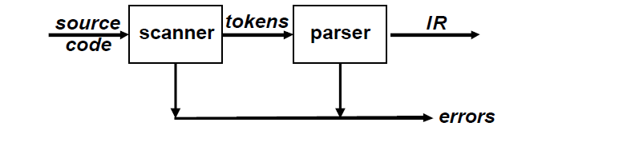
Parsing

Slide 37
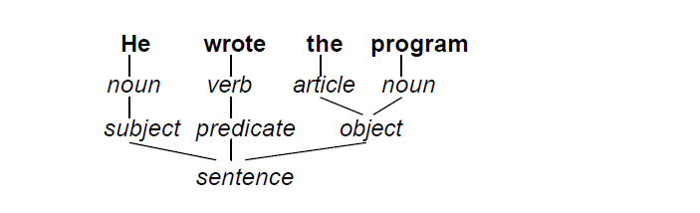

Slide 38
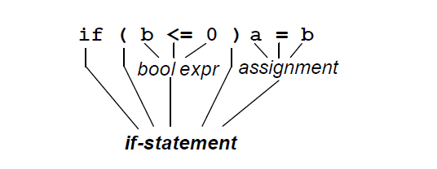

Slide 39
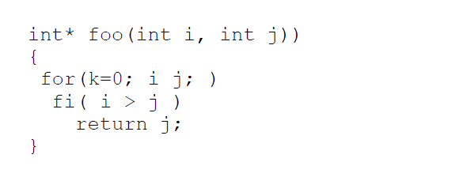

Slide 40
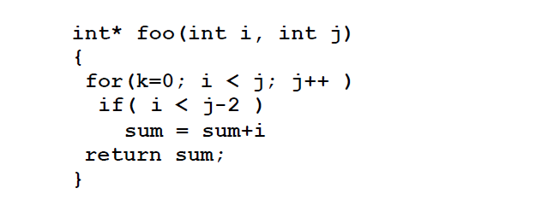

Slide 41
Syntax Analysis: What does it do?
Error reporting and recovery
Model using context free grammars
Recognize using Push down automata/Table Driven Parsers

Slide 42
What a Syntax Analyser cannot do?
To check whether variables are of types which operations are allowed.
To check whether a variable has been declared before use
To check whether a variable has been initialized
These issues will be handled in semantic analysis

Slide 43
Limitations of Regular Languages
To describe language syntax precisely and conveniently, Can regular expressions be used?
Many languages are not regular, for example, string of balanced parentheses.. "for every opening parenthesis there must be a closing parenthesis" cannot be described using a regular expression
- ((((.))))
- { ( i ) i | i = 0 }
There is no regular expression for this language
A finite automata may repeat states, however, it cannot remember the number of times it has been to a particular state.

Slide 44
Many programming languages have an inherently recursive structure that can be defined by Context Free Grammars (CFG) rather intuitively.

Slide 45
Syntax Definition:
Context free grammars
- a set of tokens (terminal symbols)
- a set of non terminal symbols
- a set of productions of the form non terminal String of terminals & non terminals
a start symbol <T, N, P, S>

Slide 46
A grammar derives strings by beginning with a start symbol and repeatedly replacing a non terminal by the right hand side of a production for that non terminal.
The strings that can be derived from the start symbol of a grammar G form the language L(G) defined by the grammar.

Slide 47
Examples
String of balanced parentheses:
S ( S ) S | ε
Grammar for a string of digits separated by + or -:
list list + digit | list - digit | digit
digit 0 | 1 | … | 9

Slide 48
list list + digit
list - digit + digit
digit - digit + digit
9 - digit + digit
9 - 5 + digit
9 - 5 + 2
Therefore, the string 9-5+2 belongs to the language specified by the grammar.
It would be interesting to know that the name context free grammar comes from the fact that use of a production X . does not depend on the context of X.

Slide 49



The simple reason is that non-terminals appear by themselves to the left of the arrow in context-free rules:
A→
The rule A→ says that A may be replaced by anywhere, regardless of where A occurs.
On the other hand, we could define a context as pair of strings such that a rule would apply only if occurs before and occurs after the non-terminal A. We would write this as
→

Slide 50
Derivations
The construction of a parse tree can be made precise by taking a derivational view, in which productions are treated as rewriting rules.

Slide 51
At each step, we choose a non-terminal to replace. Different choices can lead to different derivations.
Two derivations are of interest
1. Leftmost: replace leftmost non-terminal (NT) at each step
2. Rightmost: replace rightmost NT at each step

Slide 52
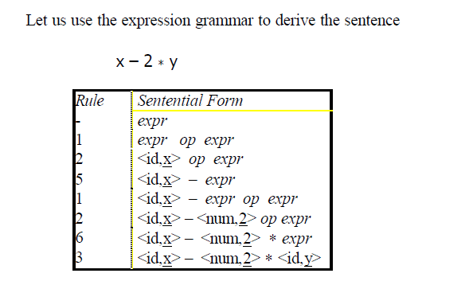

Slide 53
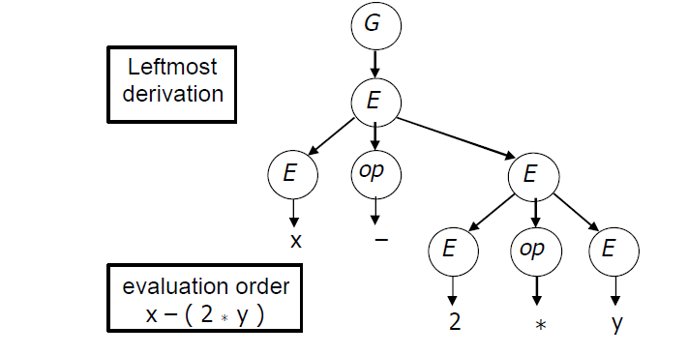
The two derivations produce different parse trees. The parse trees imply different evaluation orders!
Parse Trees
The derivations can be represented in a tree-like fashion.
The interior nodes contain the non-terminals used during the derivation

Slide 54
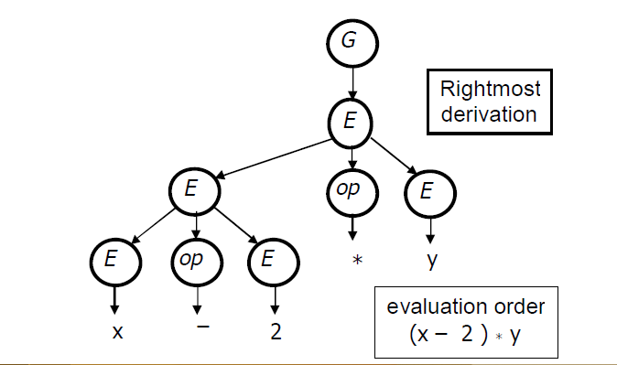

Slide 55
Context free grammars Versus Regular Expressions
Every construct that can be described by a regular expression can be described by a grammar, but not vice versa.
Alternatively, every regular language is a context free language, but not vice-versa.

Slide 56
We can construct mechanically a grammar to recognize the same language as a non deterministic finite automaton (NFA).
It uses the following construction:
For each state i of the NFA, create a non terminal Ai
If state i has a transition to state j on input a, add the production Ai→aA_{j}. If state i goes to state j on input epsilon, add the production Ai→Aj.
If i is an accepting state, add Ai→ƹ.
If i is the start state, make Ai be the start symbol of the grammar.

Slide 57
Parsing Techniques
There are two primary parsing techniques:
Top-down
Bottom-up

Slide 58
Top- down parsers:
A top-down parsers starts at the root of the parse tree and grows towards leaves.
At each node, the parser picks a production and tries to match the input.
However, the parser may pick the wrong production in which case it will need to backtrack.
Some grammars are backtrack- free.

Slide 59
Bottom-up parsers:
A bottom- up parser starts at the leaves and grows toward root of the parse tree.
As input is consumed, the parser encodes possibilities in an internal state.
The bottom- up parser starts in a state valid for legal first tokens.

Slide 60
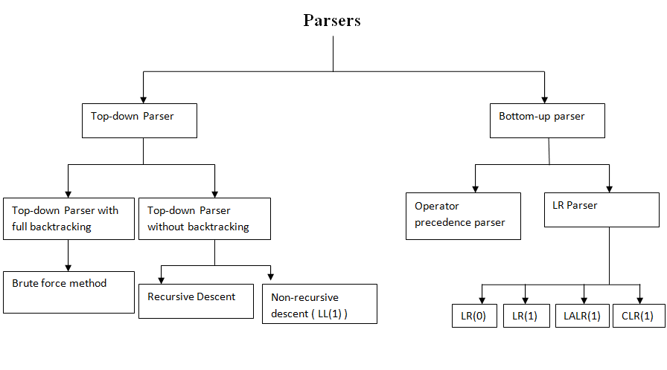

Slide 61
LL(1) Parser
The first L in LL(1) stands for scanning the input from left to right
The second L stands for producing a leftmost derivation
The “1” stands for using one input symbol of lookahead at each step to make parsing action decisions.

Slide 62
Recursive Descent Parsing
It consists of a set of procedures, one for each non terminal.
Execution begins with the procedure for the start symbol, which halts and announces success if it scans the entire input string.

Slide 63
Fig. A typical procedure for a non-terminal in a top-down parser
Void A( )
{
choose an A-production, A->X1,X2….Xk;
for(i=1….k){
if(Xi is a non-terminal)
call procedure Xi( );
else if(Xi equals the current input symbol a)
advance the input to the next symbol;
else /*an error has occurred*/;
}
}

Slide 64
Predictive parsers, that is, recursive-descent parsers needing no backtracking can be constructed for a class of grammars called LL(1).
A grammar G is LL(1) if and only if whenever A->α|β are two distinct productions of G, the following conditions hold:
For no terminal a do both α and β derive string beginning with a. (Equivalent to the statement that FIRST(α) and FIRST(β) are disjoint sets).
At most one of α and β can derive the empty string.
If ε is in FIRST(β) , then FIRST(α) and FOLLOW(A) are disjoint sets, and likewise if ε is in FIRST(α).

Slide 65
Consider the grammar
E-> iE’
E’-> +iE’/ Ԑ

Slide 66
E( )
{
if(l==‘i’)
{
match(‘i’);
E’();
}
}
E’( )
{
if(l==‘+’)
{
match(‘+’);
match(‘i’);
E’( );
}
else
return( );
}

Slide 67
match(char t)
{
if(l==t)
l=getchar();
else
printf(“error’);
}
main()
{
E();
if(l==‘$’)
printf(“parsing success”);
}

Slide 68
Non-recursive predictive parsing
A non recursive predictive parser can be built by maintaining a stack explicitly rather than implicitly via recursive calls.
The table-driven parser has an input buffer, a stack containing a sequence of grammar symbols, a parsing table constructed by a parsing algorithm and an output stream.
The input buffer contains the string to be parsed followed by the endmarker $.
We reuse the symbol $ to mark the bottom of the stack, which initially contains the start symbol of the grammar on top.

Slide 69
Bottom Up Parsing
We can think of bottom-up parsing as the process of “reducing” a string w to the start symbol of the grammar.
At each reduction step, a specific substring matching the body of a production is replaced by the non-terminal at the head of that production.
The key decisions during bottom-up parsing are about when to reduce and about what production to apply, as the parse proceeds.

Slide 70
Handle Pruning: A “handle” is a substring that matches the body of a production, and whose reduction represents one step along the reverse of a rightmost derivation.
Shift-reduce parsing: It is a form of bottom-up parsing in which a stack holds grammar symbols and an input buffer holds the rest of the string to be parsed.

Slide 71
While the primary operations are shift and reduce, there are actually four possible actions a shift-reduce parser can make:
Shift- Shift the next input symbol onto the top of the stack.
Reduce- The right end of the string to be reduced must be at the top of the stack. Locate the left end of the string within the stack and decide what non terminal to replace the string.
Accept- Announce successful completion of parsing.
Error-Discover a syntax error and call an error recovery routine.

Slide 72
Parser Generators
Parser generators exists for LL(1) and LALR(1) grammars. For eg.,
LALR(1)- YACC, Bison, CUP
LL(1)-ANTLR
Recursive Descent- JavaCC

Slide 73
The structure of the yacc file is
Declarations
%%
Translation rules
%%
Supporting C/C++ functions

Slide 74
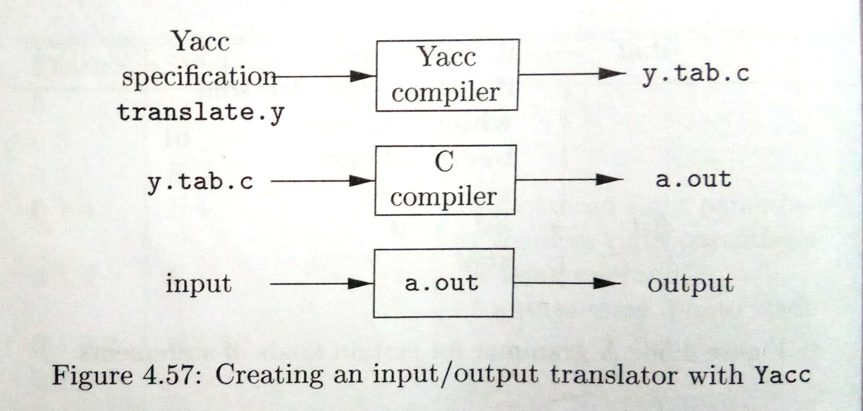

Slide 75
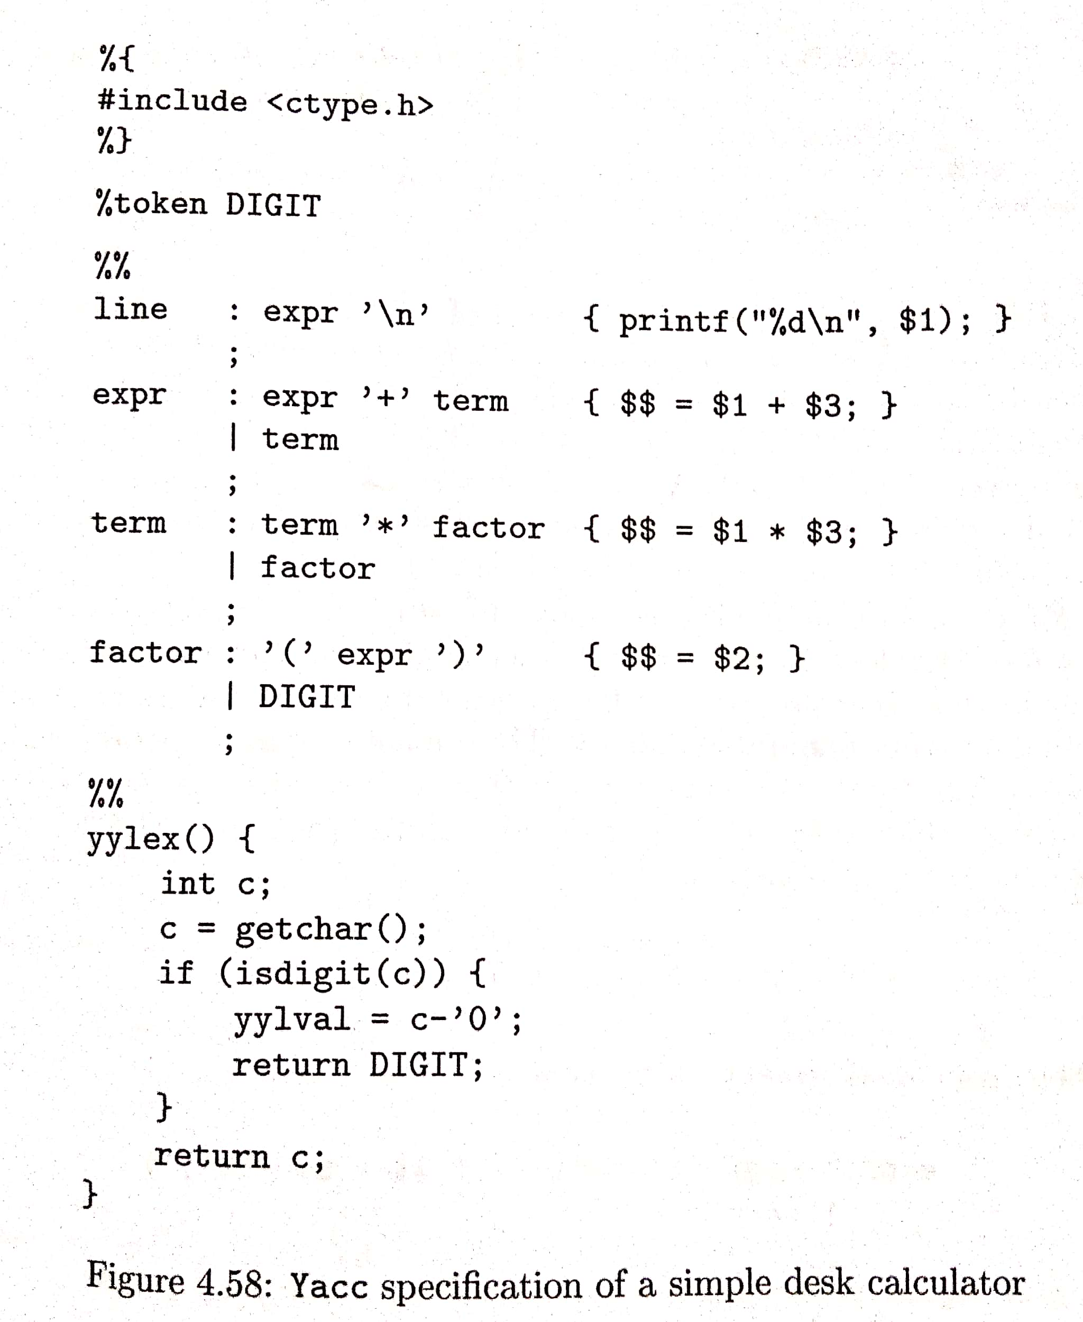

Slide 76
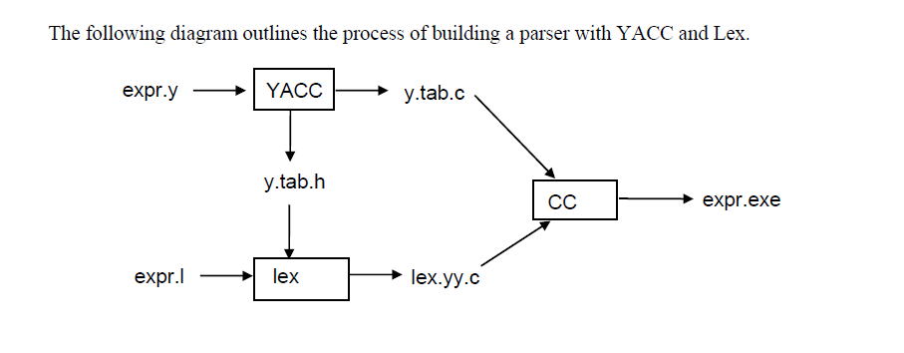

Slide 77
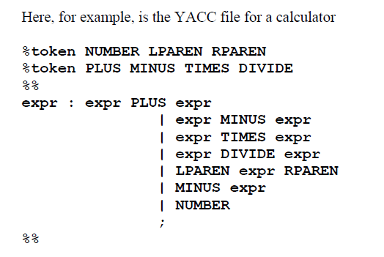

Slide 78
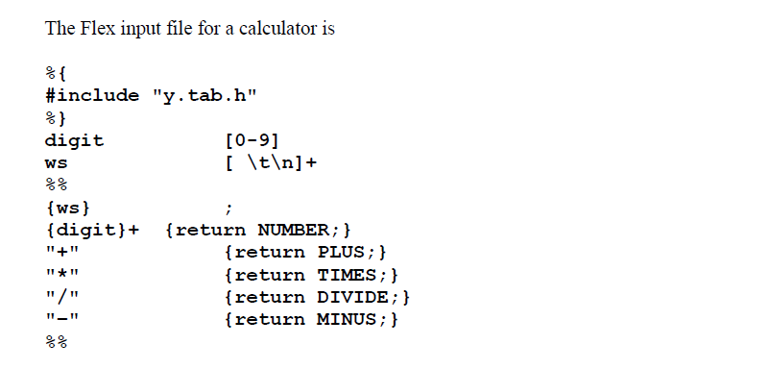

Slide 79
Semantic Analysis

Slide 80
Syntax Directed Translation
It is a systematic process of assigning meanings to programs which can also be viewed as computation of some special information(attributes) associated with the symbols of the Grammar.
To accomplish the task of syntax-directed translations, there are two general approaches:
Syntax-Directed Definitions(SDD)
Syntax-Directed Translation(SDT) Schemes

Slide 81
The conceptual view of syntax-directed translation can be presented as
Input string → Parse Tree→ Dependency graph→ Evaluation order for semantic rules

Slide 82
Syntax Analyzer as translator
Abstract Syntax Tree, Syntax Tree, intermediate code, etc.
Continuous Stream of Tokens
Parser
Syntax + Translation Rules
Fig.: Syntax Directed Translation

Slide 83
Syntax-Directed Translation
The grammar symbols are associated with attributes to associate information with the programming language constructs that they represent.
Values of these attributes are evaluated by the semantic rules associated with the grammar productions.
Any attribute may hold almost any information
It can hold a string, a number, a memory location, etc

Slide 84
Evaluation of these semantic rules:
May put information into the symbol table
May perform type checking
May issue error messages
May perform some other activities

Slide 85
Syntax –Directed Definitions and Translation Schemes
When we associate semantic rules with productions, we use two notations:
Syntax-Directed Definitions
Translation Schemes

Slide 86
Syntax-Directed Definitions:
It gives high-level specifications for translations
It hides many implementation details such as order of evaluation of semantic actions
We associate a production rule with a set of semantic actions, and we do not say when they will be evaluated.

Slide 87
Syntax-Directed Translation Schemes:
Indicate the order of evaluation of semantic actions associated with a production rule.
In other words, translation schemes give a little bit information about implementation details.

Slide 88
Syntax Directed Definitions
A SDD is a generalization of a context-free grammar in which:
Each grammar symbol is associated with a set of attributes.
This set of attributes for a grammar symbol can be of the following categories:
Synthesized attributes
Inherited attributes
Each production rule is associated with a set of semantic rules

Slide 89
In a SDD, each production A→ α is associated with a set of semantic rules of the form:
b=f(c1,c2,c3,….cn)
Where f is a function and b can be one of the following:
b is a synthesized attribute of A and c1,c2,….,cn are attributes of the grammar symbols in the production(A→ α )
b is an inherited attribute of one of the grammar symbols in α (on the right side of the production) , and c1,c2,….,cn are attributes of the grammar symbols in the production(A→ α ).

Slide 90
Terminals have only synthesized attributes whose values are provided by the scanner or the lexical analyzer.
The start non-terminal typically has no inherited attributes.
We may allow function calls as semantic-rules also; they are called “Side-effects”

Slide 91
Annotated Parse Tree
A parse tree showing the values of attributes at each node is called an annotated parse tree
The process of computing the attribute values at the nodes is called annotation (or decoration) of the parse tree.
Definitely the order of these computations depends on the dependency graph induced by the semantic rules.
Values of attributes in nodes of annotated parse-tree are either,
Initialized to constant values by the lexical analyzer
Determined by the semantic-rules

Slide 92
Evaluating Attributes
If a syntax-directed definition employs only Synthesized attributes, the evaluation of the attributes can be done in a bottom-up fashion
Inherited attributes would require more arbitrary “traversals” of the annotated parse-tree.
A dependency graph suggests possible evaluation orders for an annotated parse-tree.

Slide 93
Attribute Grammar
An attribute grammar is a formal way to define attributes for the productions of a formal grammar, associating these attributes with values.

Slide 94
Example of a Syntax-Directed Definition
Here,
The SDD is based on the grammar for arithmetic expressions which evaluates expressions terminated by an endmarker n.
Grammar symbols: L,E,T,F,n,+,*,(,), digit
Non terminals E,T,F have an attribute called val.
Terminal digit has an attribute called lexval whose value Is provided by the lexical analyzer.
PRODUCTION SEMANTIC RULE
L→ En print(E.val)
E→ E1+T E.val=E1.val+T.val
E→T E.val=T.val
T→ T1*F T.val= F.val
T→ F T.val=F.val
F→(E) F.val=E.val
F→ digit F.val=digit.lexval

Slide 95
Synthesized and Inherited attributes
Synthesized attributes are computed bottom-up fashion from the leaves upwards
Inherited attributes flow down from the parent or sibling to the node in question

Slide 96
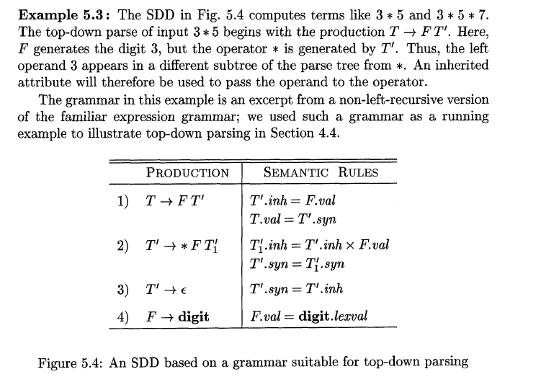

Slide 97
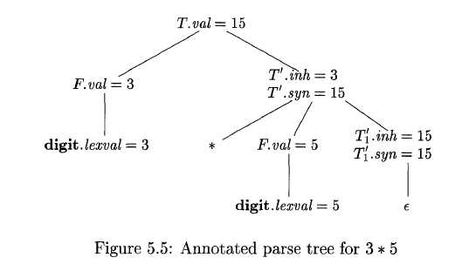
v

Slide 98
Evaluation Order for SDDs
“Dependency graphs” are a useful tool for determining an evaluation order for the attribute instances in a given parse tree.
While an annotated parse tree shows the values of attributes, a dependency graph helps us determine how those values can be computed.

Slide 99
Dependency graphs
A dependency graph depicts the flow of information among the attributes instances in a particular parse tree; an edge from one attribute instance to another means that the value of the first is needed to compute the second.
Edges express constraints implied by the semantic rules.

Slide 100
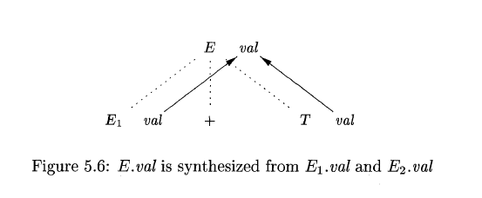
Consider the following production and rule:
PRODUCTION SEMANTIC RULE
E→ E1+T E.val = E1.val +T.val
Here, val is a synthesized attribute.
As a convention, we show the parse tree edges as dotted lines, while the edges of the dependency graph are solid.

Slide 101
Ordering the Evaluation of Attributes
The dependency graph characterizes the possible orders in which we can evaluate the attributes at the various nodes of a parse tree.
If the dependency graph has an edge from node M to node N, then the attribute corresponding to M must be evaluated before the attribute of N.
A topological sort of a directed graph is a linear ordering of its vertices such that for each directed edge xy from a vertex x to vertex y, x comes before y in the ordering.

Slide 102
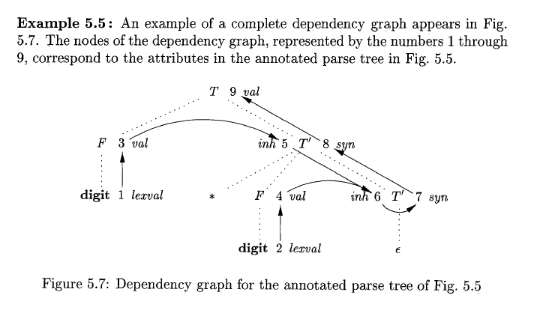
For the above graph there are other topological sorts as well, such as 1,3,5,2,4,6,7,8,9

Slide 103
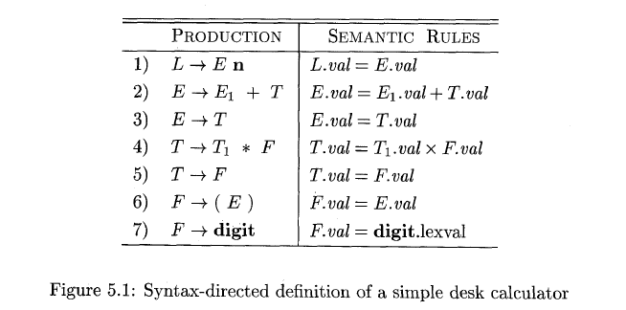
There are two important classes of SDDs:
1. S-attributed definitions: An SDD is S-attributed if every attribute is synthesized.

Slide 104
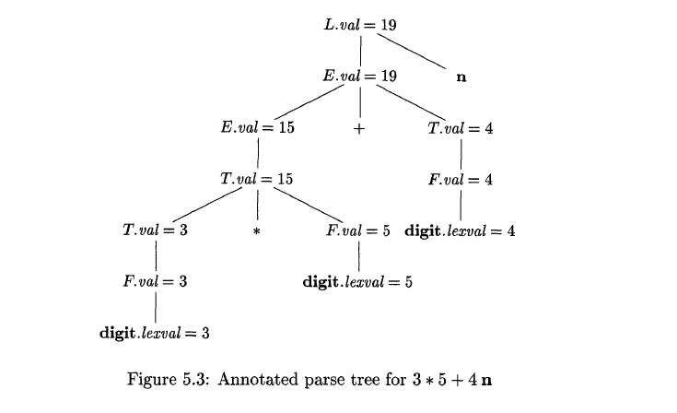

Slide 105
2. L-attributed definitions: Each attribute must be either
a. Synthesized or
b. Inherited, but with the rules limited as follows.
Suppose there is a production A→ X1X2X3…Xn, and that there is an inherited attribute Xi.a computed by a rule associated with this production. Then the rule may use only:
Inherited attributes associated with the head A
Either inherited or synthesized attributes associated with the occurrences of symbols X1,X2,X3,X4,….,Xi-1 located to the left of Xi.
Inherited or synthesized attributes associated with this occurrence of Xi itself but only in such a way that there is no cycles in a dependency graph followed by the attributes of this Xi.

Slide 108
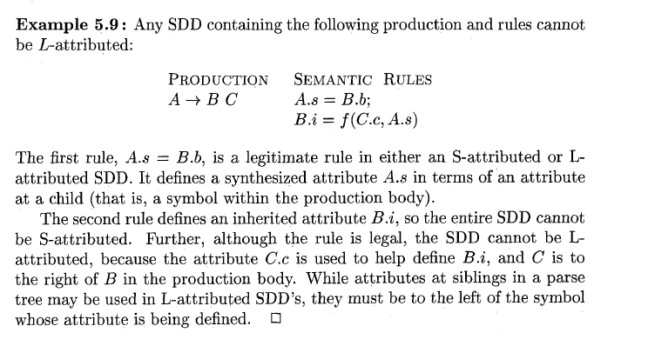

Slide 109
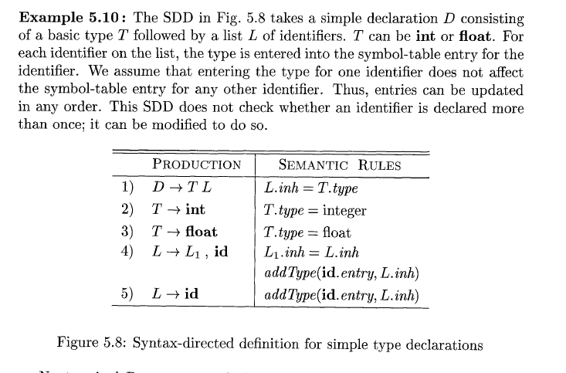

Slide 110
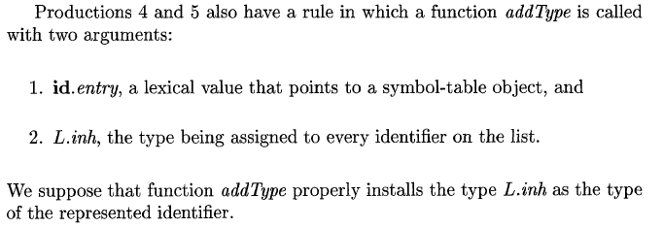

Slide 111
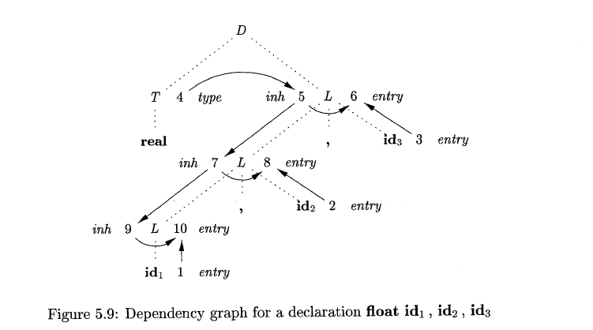

Slide 112
Given the Syntax-Directed Definition below with the synthesized attribute val, draw the annotated parse tree for the expression (3+4)*(5+6)
PRODUCTION SEMANTIC RULE
L→ En print(E.val)
E→ E1+T E.val=E1.val+T.val
E→T E.val=T.val
T→ T1*F T.val= F.val
T→ F T.val=F.val
F→(E) F.val=E.val
F→ digit F.val=digit.lexval

Slide 113
Applications of Syntax-Directed Translation
One important application of SDT is the construction of syntax trees.
Since some compilers use syntax trees as an intermediate representation, a common form of SDD turns it’s input string into a tree.
To complete the translation to intermediate code, the compiler may then walk the syntax tree, using another set of rules that are in effect an SDD on the syntax tree rather than the parse tree.

Slide 114
We consider two SDDs for constructing syntax trees for expressions.
S-attributed definition, which is suitable for use during bottom-up parsing
L-attributed definition, is suitable for use during top-down parsing

Slide 115
Construction of syntax trees
We implement the nodes of a syntax tree by objects with a suitable number of fields. Each object will have an op field that is the label of the node.
The objects will have additional field as follows:
If the node is a leaf, an additional field holds the lexical value for the leaf. The construction function Leaf(op, val) creates a leaf object. Alternatively, the nodes are viewed as records, then Leaf returns a pointer to a new record for a leaf.

Slide 116
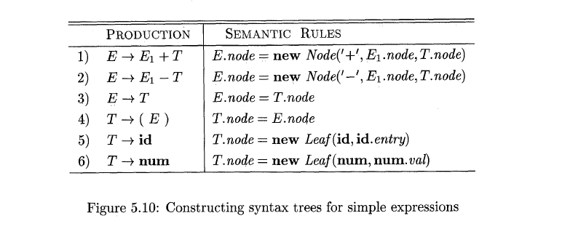
If the node is an interior node, there as many additional fields as the node has children in the syntax tree. A construction function Node takes two or more arguments: Node(op,c1,c2,….,ck) creates an object with first field op and k additional fields for the k children c1,….,ck.

Slide 117
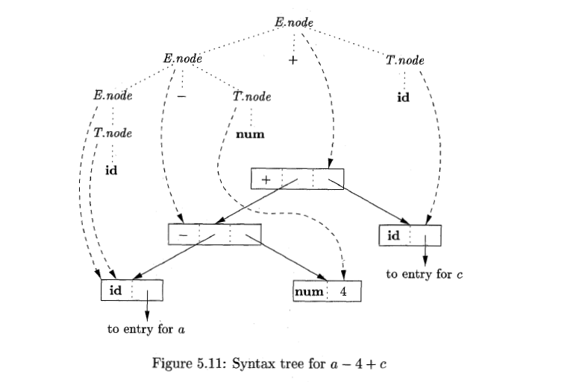
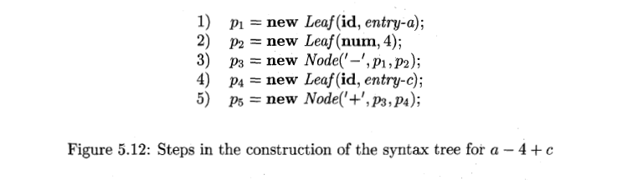

Slide 118
Intermediate Code Generation

Slide 119
In the analysis-synthesis model of a compiler, the front end analyzes a source program and creates an intermediate representation, from which the back-end generates target code.

Slide 120
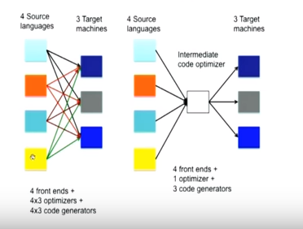
Why Intermediate code?

Slide 121
While generating machine code directly from source code is possible, it entails two problems
With m languages and n target machines, we need to write m front ends, m*n optimizers, and m*n code generators.
The code optimizer which is one of the largest and very difficult to write components of a compiler, cannot be reused.

Slide 122
By converting source code to an intermediate code, a machine independent code optimizer may be written
This means just m front ends, n code generators and 1 optimizer

Slide 123
Directed Acyclic Graphs for Expressions
Like the syntax tree for an expression, a DAG has leaves corresponding to atomic operands and interior nodes corresponding to operators.
The difference is that a node N in DAG has more than one parent if N represents a common sub expression.
In a syntax tree, the tree for the common sub expression would be replicated as many times as the sub expression appears in the original expression.

Slide 124
A DAG not only represents expressions more succintly, it gives the compiler important clues regarding the generation of efficient code to evaluate the expressions.

Slide 125
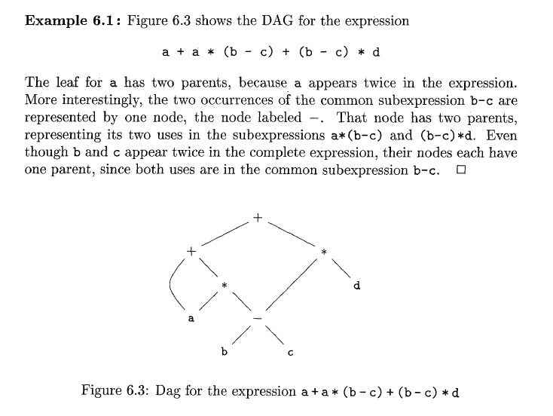

Slide 126
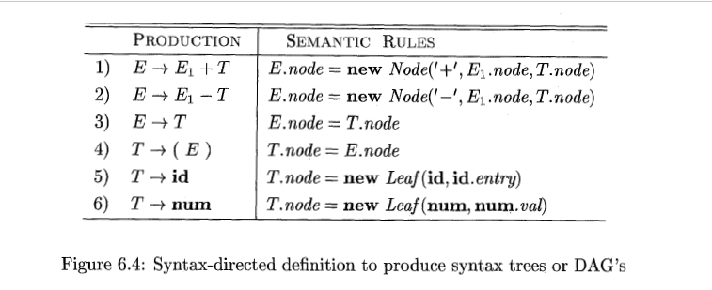

Slide 127
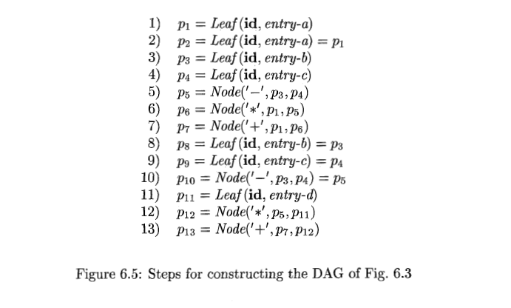

Slide 128
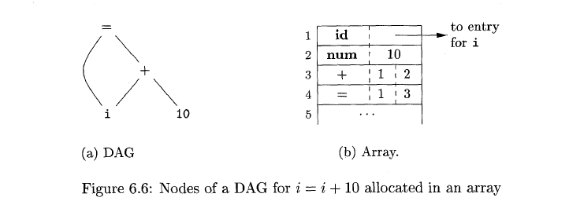
The Value-Number method for construction of a DAG

Slide 129

Three Address Code
In three-address code, there is at most one operator on the right side of an instruction; that is, no built-up arithmetic expressions are permitted.
Thus a source-language expression like x+y*z might be translated into the sequence of three-address instructions
where t1 and t2 are compiler-generated temporary names.
This unraveling of multi-operator arithmetic expressions and of nested flow-of-control statements makes three-address code desirable for target-code generation and optimization

Slide 130
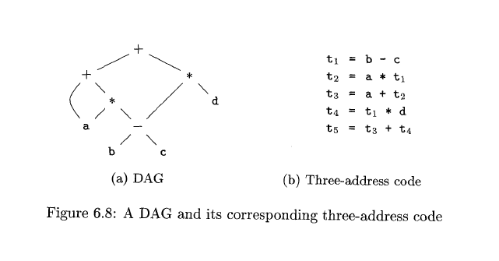

Slide 131
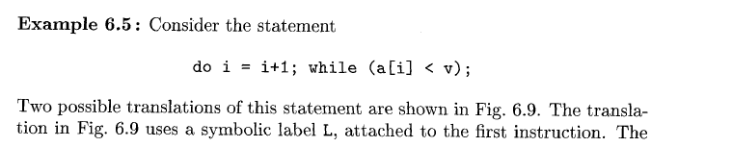
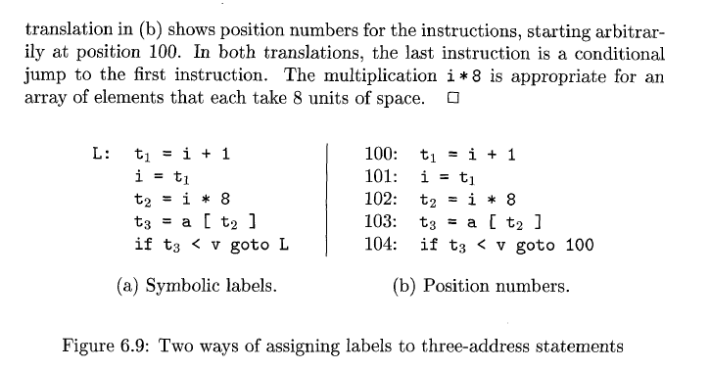

Slide 132
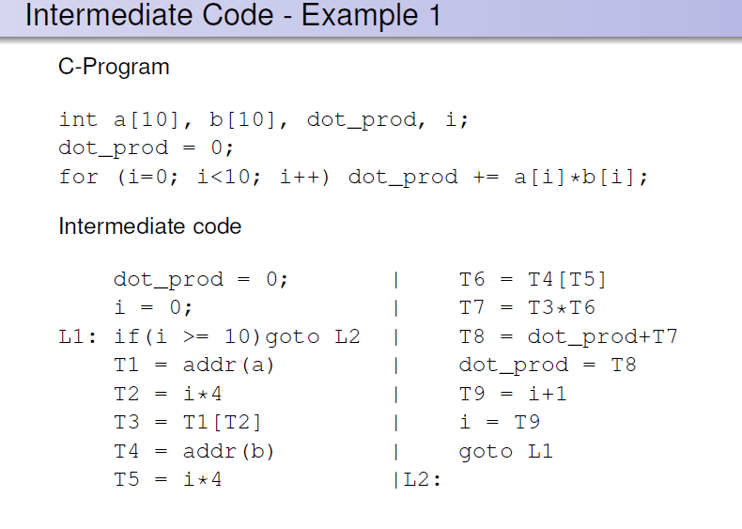

Slide 133
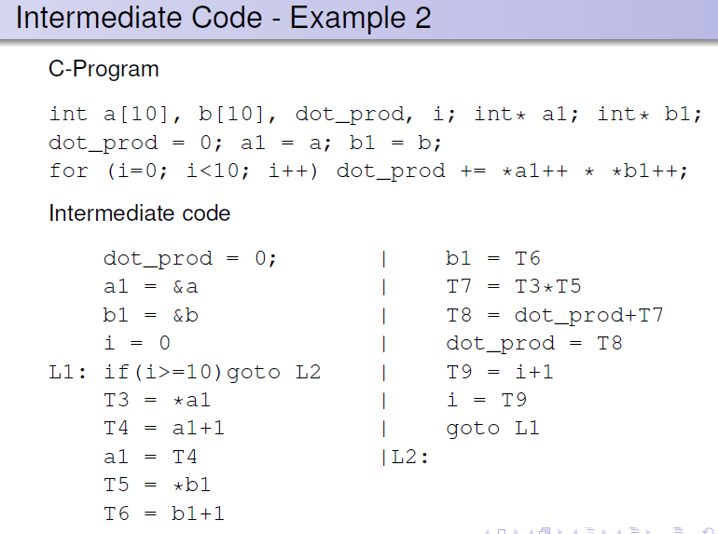

Slide 134
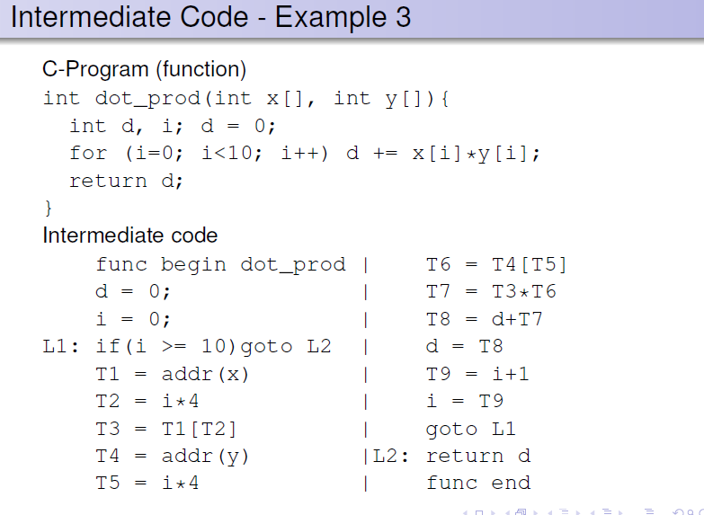

Slide 135
Three address code can be implemented using records with fields for the addresses; Quadruples, triples and indirect triples.
Quadruples: A quadruple has four fields, which we call op, arg1, arg2 and result.
The op field contains an internal code for the operator.
For instance, the three-address instruction x = y +z is represented by placing + in op, y in arg1, z in arg2, and x in result

Slide 136
There are some following exceptions to this rule:
Instructions with unary operators like x = minus y or x = y do not use arg2. Note that for a copy statement like x = y, op is =, while for most other operations, the assignment operator is implied.
Conditional and unconditional jumps put the target label in result.

Slide 137
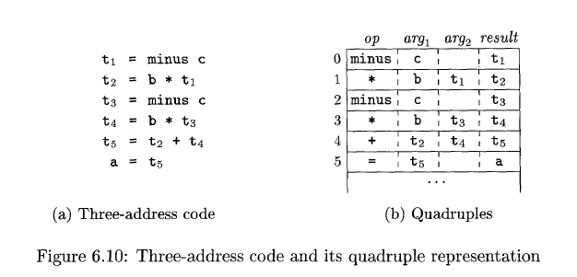

Slide 138
Triples: A triple has only three fields, which we call op, arg1, and arg2.
Using triples, we refer to the result of an operation x op y by its position, rather than by an explicit temporary name.
Thus, instead of the temporary t1 in Fig. 6.10 (b) , a triple representation would refer to position (0). Parenthesized numbers represent pointers into the triple structure itself.

Slide 139
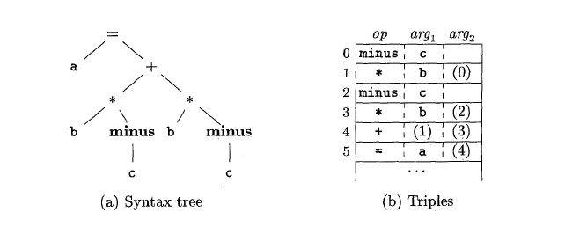

Slide 140
A benefit of quadruples over triples can be seen in an optimizing compiler, where instructions are often moved around.
With quadruples, if we move an instruction that computes a temporary t, then the instructions that use t require no change.
With triples, the result of an operation is referred to by its position, so moving an instruction may require us to change all references to that result.

Slide 141

Indirect triples : Indirect triples consist of a listing of pointers to triples, rather than a listing of triples themselves
With indirect triples, an optimizing compiler can move an instruction by reordering the instruction list, without affecting the triples themselves.

Slide 142


Slide 143
Static checking includes type checking, which ensures that operators are applied to compatible operands.
It also includes any syntactic checks that remain after parsing.
For example, static checking assures that a break-statement in C is enclosed within a while-, for-, or switch-statement; an error is reported if such an enclosing statement does not exist

Slide 144
Types
The applications of types can be grouped under checking and translation:
Type checking uses logical rules to reason about the behavior of a program at run time.
Specifically, it ensures that the types of the operands match the type expected by an operator. For example, the && operator in Java expects its two operands to be booleans; the result is also of type boolean.
Translation Applications. From the type of a name, a compiler can determine the storage that will be needed for that name at run time.

Slide 145
Storage layout for local names
From the type of a name, we can determine the amount of storage that will be needed for the name at run time.

Slide 146


Slide 147


Slide 148
Type Conversions
Consider expressions like x + i, where x is of type float and i is of type integer.
Since the representation of integers and floating-point numbers is different within a computer and different machine instructions are used for operations on integers and floats, the compiler may need to convert one of the operands of + to ensure that both operands are of the same type when the addition occurs.

Slide 149
Suppose that integers are converted to floats when necessary, using a unary operator ( f l o a t )
For example, the integer 2 is converted to a float in the code for the expression 2 * 3 .14:
t1 = (float) 2;
t2 = t1 * 3.14;

Slide 150
We introduce another attribute E.type, whose value is either integer or float.
The rule associated with E → El + E2 builds on the pseudocode
if ( E1.type = integer and E2.type = integer ) E.type = integer;
else if ( E1 .type = float and E2. type = integer ) …..

Slide 151
Type conversion rules vary from language to language.
The rules for Java in Fig. 6.25 distinguish between widening conversions, which are intended to preserve information, and narrowing conversions, which can lose information.
The widening rules are given by the hierarchy in Fig. 6.25(a): any type lower in the hierarchy can be widened to a higher type.

Slide 152


Slide 153
Thus, a char can be widened to an int or to a float, but a char cannot be widened to a short.
The narrowing rules are illustrated by the graph in Fig. 6.25(b): a type s can be narrowed to a type t if there is a path from s to t.
Note that char, short, and byte are pairwise convertible to each other.

Slide 154
Conversion from one type to another is said to be implicit if it is done automatically by the compiler.
Implicit type conversions, also called coercions, are limited in many languages to widening conversions.
Conversion is said to be explicit if the programmer must write something to cause the conversion.
Explicit conversions are also called casts.

Slide 155
The semantic action for checking E → E1 + E2 uses two functions:
1. max(t1, t2) takes two types t1 and t2 and returns the maximum of the two types in the widening hierarchy. It declares an error if either t1 or t2 is not in the hierarchy.

Slide 156
2. widen(a, t, w) generates type conversions if needed to widen an address a of type t into a value of type w. It returns a itself if t and w are the same type. Otherwise, it generates an instruction to do the conversion and place the result in a temporary t, which is returned as the result.
Pseudocode for widen, assuming that the only types are, integer and float, appears in Fig. 6.26.

Slide 157


Slide 158


Slide 159
Code Optimization Techniques
Constant Folding
-It refers to a technique of evaluating the expressions whose operands are known to be constant at compile time itself.
Eg. a= (22/7)*d
Constant propagation
- In constant propagation, if a variable is assigned a constant value, then subsequent use of that variable can be replaced by a constant as long as no intervening assignment has changed the value of the variable.
Eg. Pi=3.14
r=5
area=pi*r*r

Slide 160
Common sub-expression elimination
This technique replaces redundant expression each time it is encountered.
Example: T1=4*i
T2=a[T1]
T3=4*j
T4=4*i
T5=n
T6=b[T4]+T5
Before optimization
T1=4*i
T2=a[T1]
T3=4*j
T5=n
T6=b[T1]+T5
After Optimization

Slide 161
4. Code Movement
It is a technique of moving a block of code outside a loop if it won’t have any difference outside or inside the loop.
Example:
x=y+z;
for(int i=0;i<n;i++)
{
a[i]=6*I;
}
After Optimization
for(int i=0;i<n;i++)
{
x=y+z;
a[i]=6*I;
}
Before Optimization

Slide 162
5.Dead Code Elimination
This method involves eliminating those code statements which are either never executed or unreachable or if executed their output is never used.
Example
i=0;
If(i==1)
{
a=x+5;
}
Before Optimization
i=0
After Optimization

Slide 163
6. Strength Reduction
It is the replacement of expressions that are expensive with cheaper and simple ones.
Example:
B=A*2;
Before Optimization
B=A+A;
After Optimization

Slide 164
Basic Blocks and Flow Graphs
Helps in the identification of loops in the code for code optimization process
First job is to partition a sequence of three-address instructions into basic blocks.

Slide 165


Slide 166


Slide 167


Slide 168


Slide 169


Slide 170


Slide 171


Slide 172
Code Generation

Slide 173

Code Generation
Notes:
Requirements imposed on the code generator:
The target program must preserve the semantic meaning of the source program and be of high quality; that is, it must make effective use of the available resources of the target machine.
The code generator itself must run efficiently.

Slide 174
Three primary tasks of code generator:
Instruction selection: involves choosing appropriate target-machine instructions to implement the IR statements
Register allocation and assignment involves deciding what values to keep in which registers.
Instruction ordering involves deciding in what order to schedule the execution of instructions.

Slide 175
A simple Target Machine Model
Our target computer models a three-address machine with load and store operations, computation operations, jump operations, and conditional jumps.
The underlying computer is a byte-addressable machine with n general-purpose registers, RO, R1, . . . , Rn - 1

Slide 176
We assume the following kinds of instructions are available:
Load operations: The instruction LD dst, addr loads the value in location addr into location dst.
Store operations: The instruction ST x, r stores the value in register r into the location x.
Computation operations of the form OP dst, srcl, src2, where OP is a operator like ADD or SUB, and dst, srcl , and src2 are locations.

Slide 177
Unconditional jumps: The instruction BR L causes control to branch to the machine instruction with label L. (BR stands for branch.)
Conditional jumps of the form Bcond r, L, where r is a register, L is a label, and cond stands for any of the common tests on values in the register r.
For example, BLTZ r, L causes a jump to label L if the value in register r is less than zero, and allows control to pass to the next machine instruction if not.

Slide 178
Addressing Modes
We assume our target machine has a variety of addressing modes:
In instructions, a location can be a variable name x referring to the memory location that is reserved for x
A location can also be an indexed address of the form a(r), where a is a variable and r is a register.
For example, the instruction LD R1, a(R2) has the effect of setting Rl = contents (a +contents (R2)), where contents(x) denotes the contents of the register or memory location represented by x.
Notes:
This addressing mode is useful for accessing arrays, where a is the base address of the
array (that is, the address of the first element), and r holds the number
of bytes past that address we wish to go to reach one of the elements of
array a.

Slide 179
A memory location can be an integer indexed by a register. For example, LD R1, 1OO(R2) has the effect of setting R1 =contents(100+contents(R2))that is, of loading into R1 the value in the memory location obtained by adding 100 to the contents of register R2.
Notes:
*1This feature
is useful for following pointers

Slide 180
Two indirect addressing modes: *r means the memory location found in the location represented by the contents of register r and *100(r) means the memory location found in the location obtained by adding 100 to the contents of r.
For example, LD R1, *100 (R2) has the effect of setting R1 = contents(contents(100+contents(R2))), that is, of loading into R1 the value in the memory location stored in the memory location obtained by adding 100 to the contents of register R2.

Slide 181
Immediate constant addressing mode: The constant is prefixed by #. The instruction LD R1, #100 loads the integer 100 into register R1, and ADD R1, R1, #100 adds the integer 100 into register R1.

Slide 182
Program and Instruction Costs
Cost of Instruction=1+ costs associated with the addressing modes of the operands
Addressing modes involving registers have zero additional cost, while those involving a memory location or constant in them have an additional cost of one.
We assume the cost of a target-language program on a given input is the sum of costs of the individual instructions executed when the program is run on that input

Slide 183
Example:
The instruction LD RO, R1 copies the contents of register R1 into register RO. This instruction has a cost of one because no additional memory words are required.
The instruction LD RO, M loads the contents of memory location M into register RO. The cost is two.
The instruction LD R1, *100(R2) loads into register R1 the value given by contents(contents(l00 + contents(R2))). The cost is two.

Slide 184



Slide 185



Slide 186



Slide 187



Slide 188


Slide 189

1. 2 + 2 + 1 + 2 = 7
2. 2 + 2 + 2 + 2 = 8
3. 2 + 2 + 2 + 2 = 8

Slide 190
Recursive Descent Parsing
It consists of a set of procedures, one for each non terminal.
Execution begins with the procedure for the start symbol, which halts and announces success if it scans the entire input string.

Slide 191
Fig. A typical procedure for a non-terminal in a top-down parser
Void A( )
{
choose an A-production, A->X1,X2….Xk;
for(i=1….k){
if(Xi is a non-terminal)
call procedure Xi( );
else if(Xi equals the current input symbol a)
advance the input to the next symbol;
else /*an error has occurred*/;
}
}

Slide 192
Consider the grammar
E-> iE’
E’-> +iE’/ Ԑ

Slide 193
E( )
{
l=getchar();
if(l==‘i’)
{
match(‘i’);
E’();
}
}
E’( )
{
if(l==‘+’)
{
match(‘+’);
match(‘i’);
E’( );
}
else
return( );
}

Slide 194
match(char t)
{
if(l==t)
l=getchar();
else
printf(“error’);
}
main()
{
E();
if(l==‘$’)
printf(“parsing success”);
}

